Slide 1
Music - The Universal Language of Mankind
Harish R Sharma
Philips
03_29_2023

Slide 2
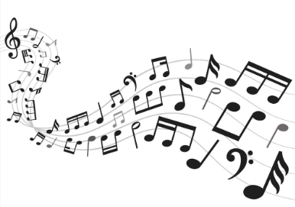
What is Music ?
Combination of sounds in such a way as to produce beauty of form, harmony, and expression of emotion

Slide 3
Three dimensions of measuring music
Arousal
Represents physiological mechanisms such as arousal and relaxation
Intense, Vigorous, Abrasive, Exciting vs. Gentle, Mellow
Valence
Reflects the emotion and mood processes
Fun, Happy, Lively, Enthusiastic, Joyful vs. Depressing, Sad
Depth
Represents cognitive processes
Intelligent, Sophisticated, Inspirational, Nuanced, Poetic, Deep, Emotional, Reflective vs. Party music, danceable

Slide 4
Types of Music
Rock Music
Strong beats (rhythmic element)
Electronic Music
Electromechanical
Country Music
Ballads and Dance tunes
Hip-Hop
Rap music (Rhythmic speech)
Beatbox
DJ
Traditional and Folk Music

Slide 5
Indian Music
Indian Music
Classical Music
Folk Music
Modern Music
Rabindra Sangeet
Fusion
Hindustani
Sugam Sangeet
Carnatic
Haveli Sangeet

Slide 6
Elementary ideas in Carnatic Music
Shruti (Swara) (Pitch)
Mata (Mother of music)
smallest interval of pitch that the human ear can detect and a singer or musical instrument can produce
Laya (Tala)
Pita (Father of music)
Measured in length of time
Rhythm component of music
Swaras :
Sa | Ri | Ga | Ma | Pa | Da | Ni | Sa
C | D | E | F | G | A | B | C

Slide 7
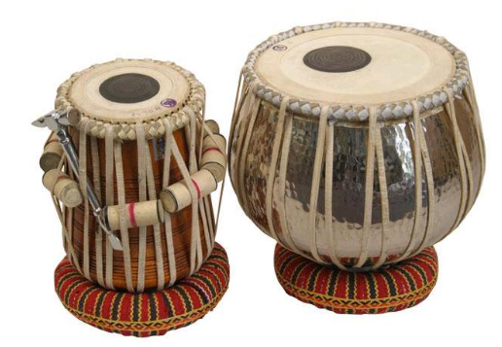
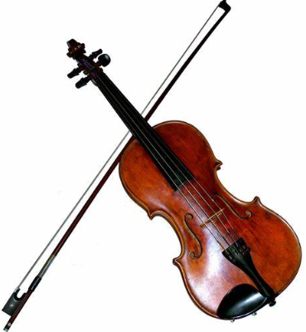
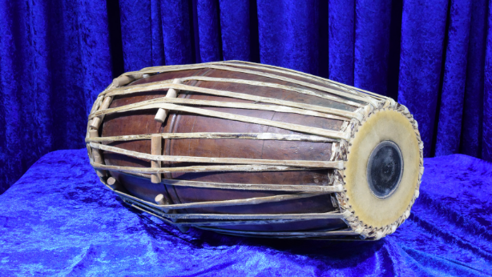
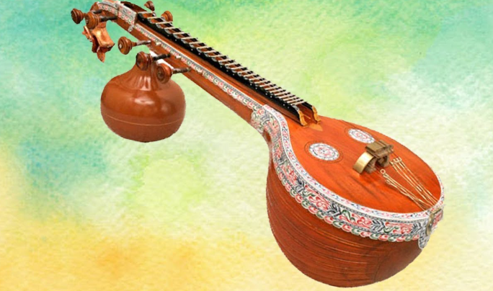
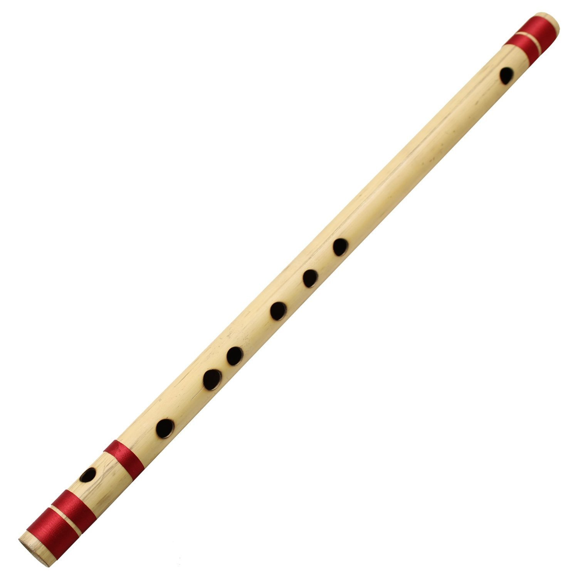
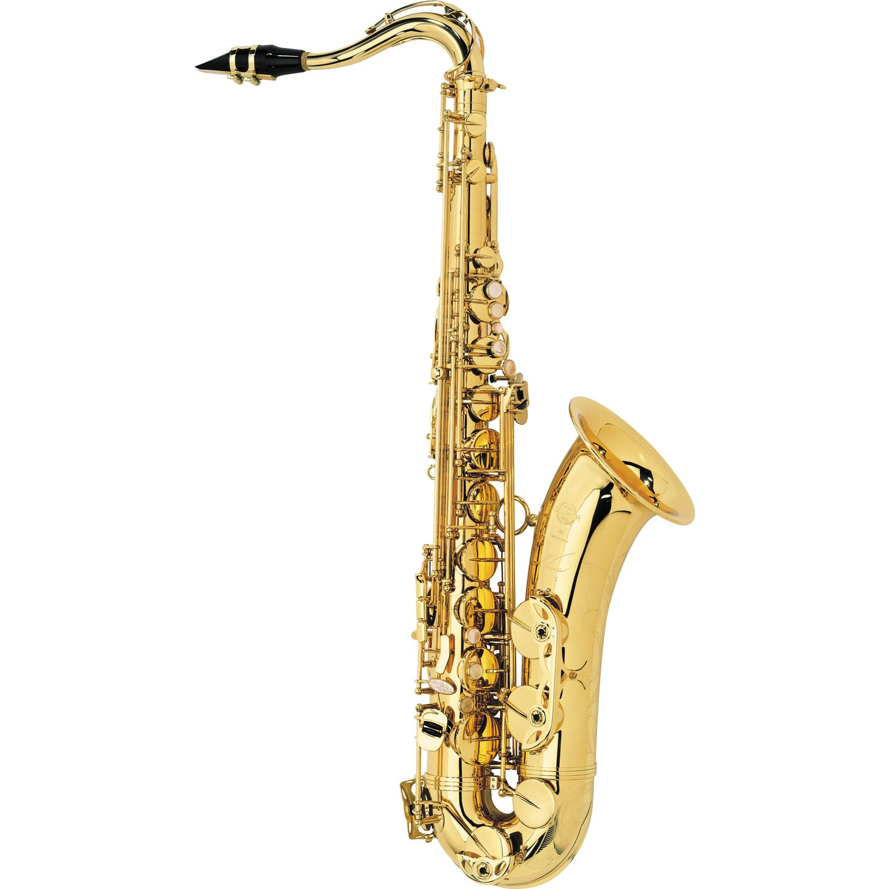
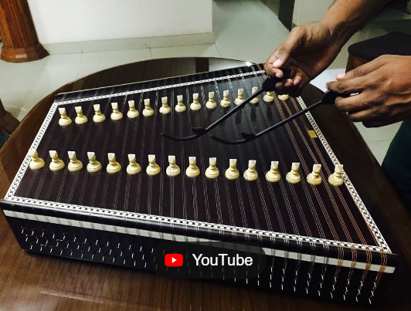
Types of Musical Instruments
Percussion instruments
String Instruments
Wind instruments

